Slide 1
Project 76 Group 04 Submitted by: Shreyas Anusha Meesala Anandhanarayanan A Pushkar Shanmukha Sri Vastava G Narayana venkatalohith

Slide 2
Business Problem Need to perform clustering to summarize customer segments.

Slide 3
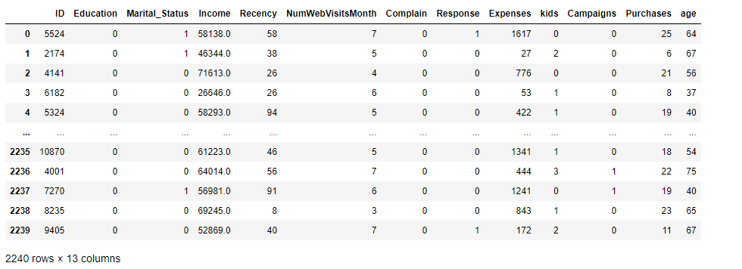
Label encoding
Perform label encoding on “Marital Status” & “Education” columns

Slide 4
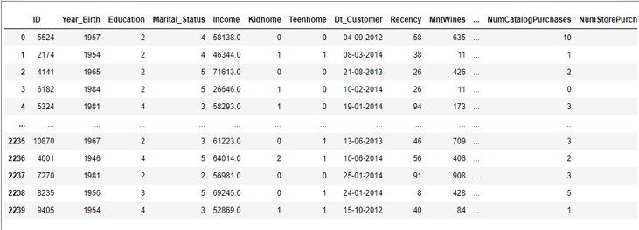
Dataset

Slide 5
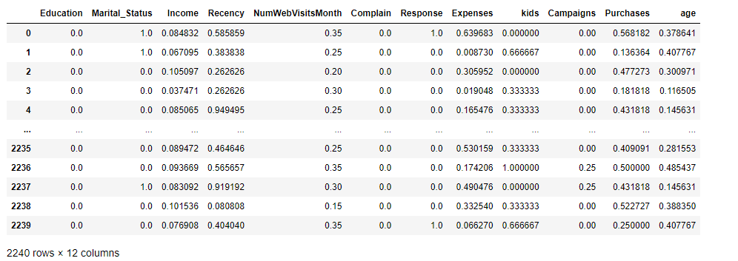
Scaling and Normalization
→ from sklearn.preprocessing import normalize
→ data_scaled = normalize(data1)
→ data_scaled = pd.DataFrame(data_scaled, columns=data1.columns)
→ data_scaled.head()

Slide 6
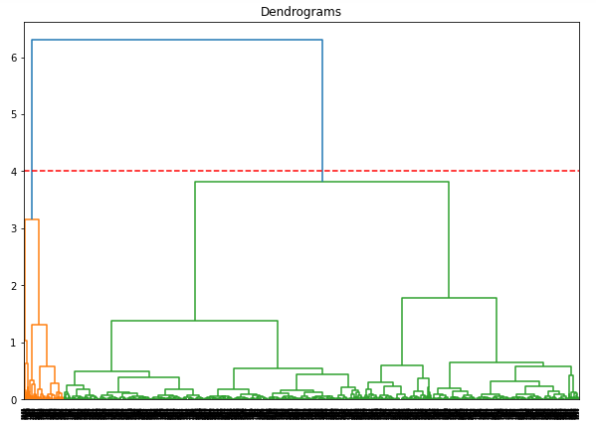
Hierarchical Clustering
Perform Dendrogram
1. Dendrogram with WARD Linkge :
dend = sch.dendrogram(sch.linkage(data_scaled, method='ward'))
The vertical line with maximum distance is the blue line and hence we can decide a threshold and cut the dendrogram

Slide 7
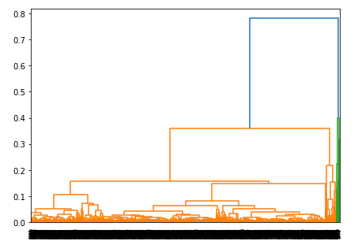
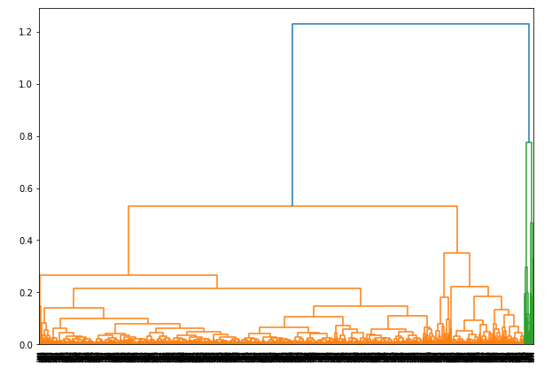
2. Dendrogram with AVERAGE Linkage :
3. Dendrogram with COMPLETE Linkage :

Slide 8
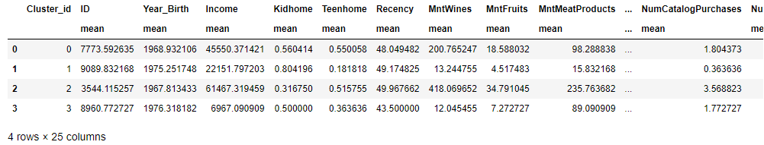
Agglomerative Clustering
→ hc=AgglomerativeClustering(n_clusters=4,affinity='euclidean',linkage="ward")
Group data by Cluster ID :
→ df.groupby("Cluster_id").agg(['mean']).reset_index()

Slide 9
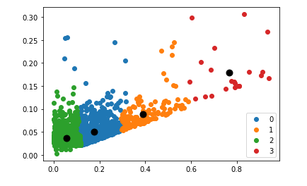
Getting centroid for AgglomerativeClustering :
→ from sklearn.neighbors.nearest_centroid import NearestCentroid
→ clf = NearestCentroid()
→ clf.fit(data_scaled, label)
Centroid for all clusters :

Slide 10
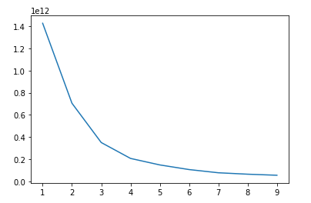
Kmeans clustering
Elbow curve / Scree plot :

Slide 11
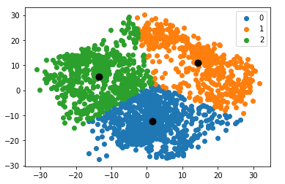
Apply K-Means to the Data :
#Import required module
→ from sklearn.cluster import KMeans
#Initialize the class object
→ kmeans = KMeans(n_clusters= 3)
#predict the labels of clusters.
→ label = kmeans.fit_predict(df1)
→ print(label)
Plot All K-Means Clusters :

Slide 12
DBSCAN Clustering
Apply Dbscan :
db_default = DBSCAN(eps=0.4, min_samples=5).fit(X_principal)
#predict the labels of clusters.
→ labels = db_default.fit_predict(X_principal)
print(labels)
Getting unique labels :
#Getting unique labels
u_labels = np.unique(labels)

Slide 13
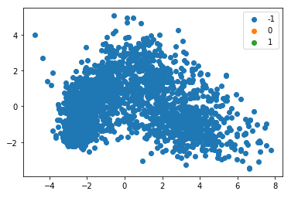
plotting the results:
→ for i in u_labels:
→ plt.scatter(X_principal[labels == i , 0] , X_principal[labels == i , 1] , label = i)
→ plt.legend()
→ plt.scatter(clf.centroids_[:,0] , clf.centroids_[:,1] , s = 80, color = 'k')
→ plt.legend()
→ plt.show()

